Slide 1
Multiple Disease Prediction using ML
TS- WEB/CC/AI TRACK CAPSTONE PROJECT
Presented By:
Miss Tarugu Dharani – IIIT RGUKT RK VALLEY
Guided By: Poovaragavan Velumani
Master Trainer

Slide 2
OUTLINE
Abstract
Problem Statement
Aims , Objective & Proposed System/Solution
System Design
System Development Approach(Technology Used)
Algorithm & Deployment
Conclusion
References
Future Scope

Slide 3
Abstract
Many of the existing machine learning models for health care analysis are concentrating on one disease per analysis. Like one analysis if for diabetes analysis, one for brain diseases like that. There is no common system where one analysis can perform more than one disease prediction. In this project proposing a system which used to predict multiple diseases by using Streamlit in Python.
. To implement multiple disease analysis used machine learning algorithms, Streamlit and web designing. Python pickling is used to save the model behaviour and python unpickling is used to load the pickle file whenever required.
After user accessing this website, the user has to send the parameters of the disease along with disease name. This website will invoke the corresponding model and returns the status of the patient. The importance of this analysis to analyse the two diseases, so that to monitor the patient’s condition and warn the patients in advance to decrease mortality ratio

Slide 4
Problem Statement
The main aim is to predict the prediction efficiency that would be beneficial for the patients who are suffering from Diabetes , Parkinson and the percentage of the disease will be reduced. Generally in the first stage, these can be cured by treatment.
so it’s important to identify the PD at the early stage for the betterment of the patients.The main purpose of this project is to find the best prediction model i.e. the best machine learning technique which will distinguish the patient from the healthy person.
The techniques used in this problem are SVM , Logistic Regression. The experimental study is performed on the dataset of Diabetes , voice dataset of Parkinson’s patients which is downloaded from the Kaggle.
The prediction is evaluated using evaluation metrics like confusion matrix, precision, recall accuracy, and f1-score. We used where the important features are taken into consideration to detect Diabetes , Parkinsons.

Slide 5
Proposed Solution
In multi disease model prediction, it is possible to predict more than one disease at a time. So user no need to traverse many models to predict the diseases. It will reduce time and also due to predicting multiple diseases at a time there Is a chance of reducing mortality rate.

Slide 6
System Architecture
Machine learning has given computer systems the ability to automatically learn without being explicitly programmed. In this project, we used machine learning algorithm (SVM). The architecture diagram describes the highlevel overview of major system components and important working relationships. It represents the flow of execution and it involves the following five major steps:
Speech Dataset
• Pre-processing data
• Training data
• Apply Machine Learning Algorithm
SVM
• Testing Data

Slide 7
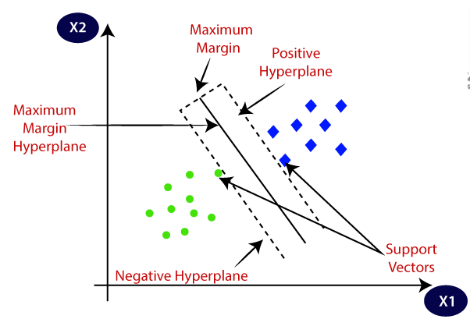
System Deployment Approach
Vector Machine or SVM is one of the most popular Supervised Learning algorithms, which is used for Classification as well as Regression.
However, primarily, it is used for Classification problems in Machine Learning. The goal of the SVM algorithm is to create the best line or decision boundary that can segregate n-dimensional space into classes so that we can easily put the new data point in the correct category in the future. This best decision boundary is called a hyperplane. SVM chooses the extreme points/vectors that help in creating the hyperplane. These extreme cases are called support vectors, and hence the algorithm is termed as Support Vector Machine.

Slide 8
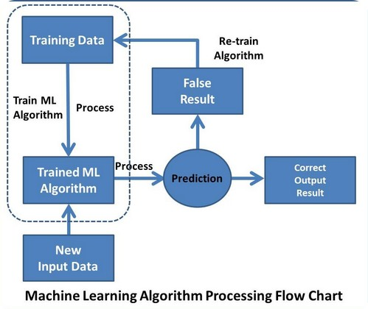
Algorithm & Deployment

Slide 9
Conclusion
Diabetes is a very serious disease with many life threatening consequences, but if it is taken care of properly, diabetes can live a normal life. Parkinson’s disease is the second most dangerous neurodegenerative disease which has no cure till now and to make it reduce prediction is important. In this project, we have used prediction model(SVM) to predict the Diabetes, Parkinson’s disease which are Machine Learning Technique.
The dataset is trained using these models and we also compared these different models built. We have used the dataset that contains some features of the patients which is available in the Kaggle website. The dataset consists of more than 700 features and 750 patient details. The models are built using the some best features which were identified by feature selection. This system we designed can make the predictions of the Diabetes and Parkinson’s disease.

Slide 10
References
[1] Md. Redone Hassan,etal, “A Knowledge Base Data Mining based on Parkinson’sDisease” International Conference on System Modelling & Advancement in ResearchTrends, 2019.
[2] R. P. Duncan, A. L. Leddy, J. T. Cavanaugh et al., “Detecting and predicting balance decline in Parkinson disease: a prospective cohort study” Journal of Parkinson’s Disease,vol-5, no. 1, pp. 131–139, 2015.
[3] T. J. Wroge, Y. Özkanca, C. Demiroglu, D. Si, D. C. Atkins and R. H. Ghomi,"Parkinson’s Disease Diagnosis Using Machine Learning and Voice," IEEE Signal Processing in Medicine and Biology Symposium (SPMB), pp.1-7.

Slide 11
Future work
In future, these models can be trained with different datasets that have best features and can be predicted more accurately. If the accuracy rate increases, it can be used by the laboratories and hospitals so that it is easy to predict in early stages.
This models can be also used with different medical and disease datasets. In future the work can be extended by building a hybrid model that can find more than three diseases with an accurate dataset and that dataset has common features of two diseases.
In future the work can extended to build a model that may extract more important features among all features in the dataset so that it produce more accuracy

Slide 12
THANK YOU

